Slide 1
Neural Language Modeling
Group 4:
Kishan Vaishnani - 202011004
Dhyanil Mehta - 202011032
Darshil Patel - 202011034
Akash Dhedhi - 202011053
Tarang Ranpara - 202011057

Slide 2
Timeline
1986
Recurrence Based Architectures
The dominant sequence transduction models are based on complex recurrent or convolutional neural networks that include an encoder and a decoder. The best performing models also connect the encoder and decoder through an attention mechanism.
2017
Transformers
new simple network architecture, the Transformer, based solely on attention mechanisms, dispensing with recurrence and convolutions entirely
2020
Big Bird
Big Bird uses a sparse attention mechanism that reduces the quadratic dependency for storing self attention to linear.

Slide 3
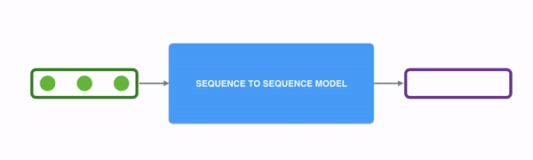
Why Transformers?
In sequence-to-sequence problems such as the neural machine translation, the initial proposals were based on the use of RNNs in an encoder-decoder architecture.

Slide 4
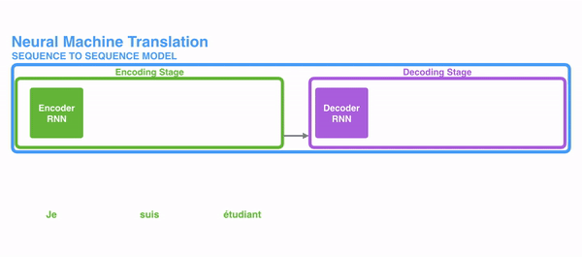
Continued
These architectures have a great limitation when working with long sequences, their ability to retain information from the first elements was lost when new elements were incorporated into the sequence.

Slide 5
Continued
Therefore, if the decoder only accesses the last hidden state of the encoder, it will lose relevant information about the first elements of the sequence. Then to deal with this limitation, a new concept were introduced the attention mechanism.

Slide 6
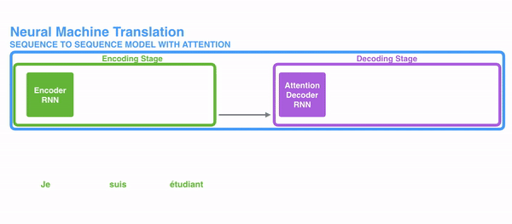
Attention!

Slide 7
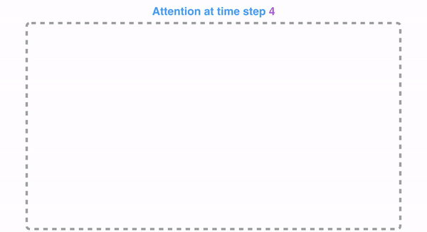
Attention computation

Slide 8
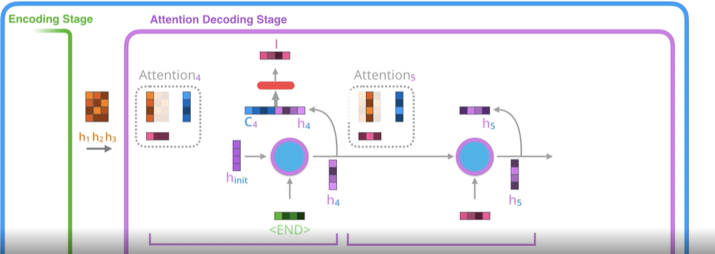
Attention in action!

Slide 9
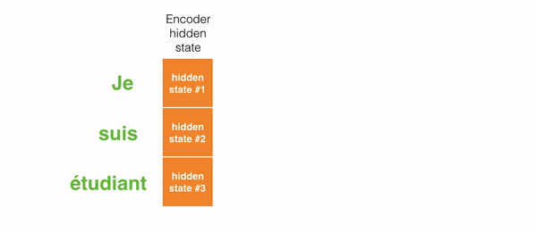
Visualization of attention

Slide 10
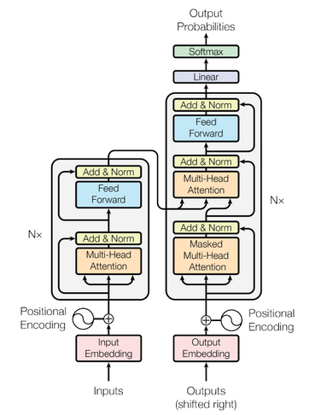
Transformers!
“Transformer” is self-attention based model which was originally used for translation task.
It has stack of encoders connected with stack of decoders
Unlike RNNs/LSTMs, it takes every input at once.
It uses full self-attention and token wise feed-forward networks which helps in parallelization process!
In encoder, full self attention is used while in decoders, masked self-attention is used followed by full one.

Slide 11

Continued

Slide 12
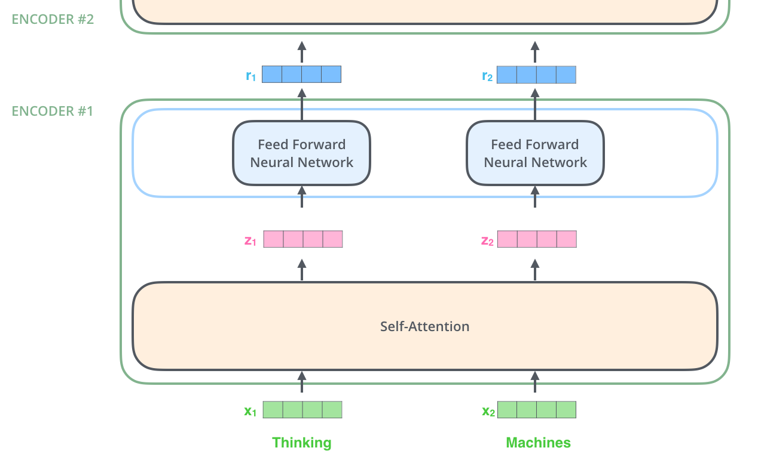
Encoder from higher level

Slide 13

Self attention
The Transformer model extract features for each word using a self-attention mechanism to figure out how important all the other words in the sentence are w.r.t. to the aforementioned word.
Answers the question, What “it” is referring to?

Slide 14

Continued
The first step in calculating self-attention is to create three vectors from each of the encoder’s input vectors. So for each word, we create a Query vector, a Key vector, and a Value vector.

Slide 15

Continued
Attention calculation steps:
For every input, dot product of its q is taken with every input’s k
Then results are divided by the dimension of k vector
After the division operation, their softmax is computed.
Softmax values are then multiplied with values of each input
Values are then summed up to get the attention vector for that input!

Slide 16
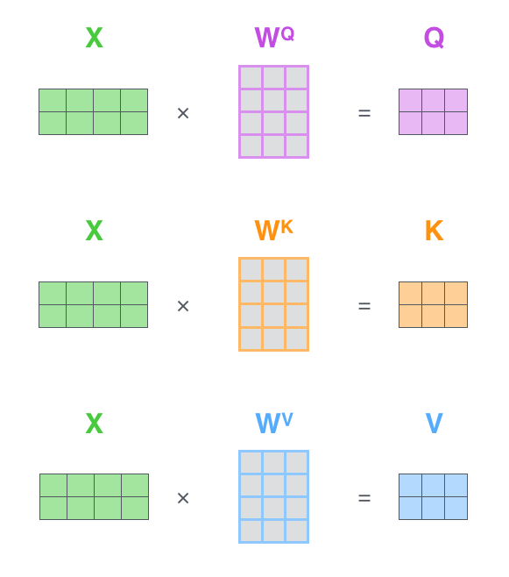

Vectorized implementation

Slide 17

Multi-head attention

Slide 18

Encoder
To preserve the the past knowledge, residual(shortcut) connections are used.
In layer norm, z(immediate output) and x(shortcut connection) are added and then normalized.

Slide 19

The Bigger Picture
To focus on specific part of input, decoder uses encoder-decoder attention.
In encoder-decoder attention, K and V are calculated from last encoder, which then help us calculate attention values as mentioned earlier in the decoder.

Slide 20

Decoder in action

Slide 21
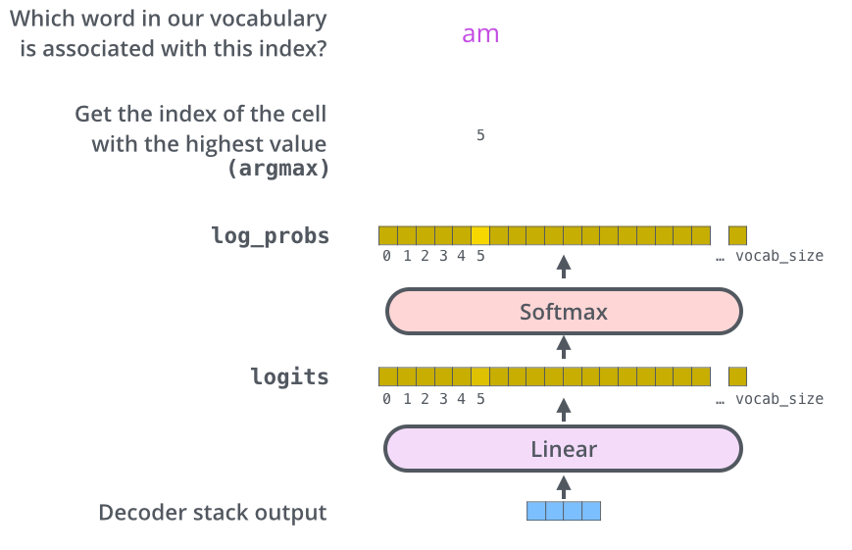
Final classification layer
It computes probabilities for every word in vocab
Applies softmax to highest probable word.

Slide 22
Positional Encoding
Positional encoding is represented by a matrix. For sequence length T and model depth D, this would be a (T, D) tensor.
The “positions” are just the indices in the sequence.
Each row of the PE matrix is a vector that represents the interpolated position of the discrete value associated with the row index
The row-vector is an alternating series of sines and cosines, with frequencies that decrease according to a geometric series
There exists a matrix multiplication that can shift the position of any row-vector we want.

Slide 23
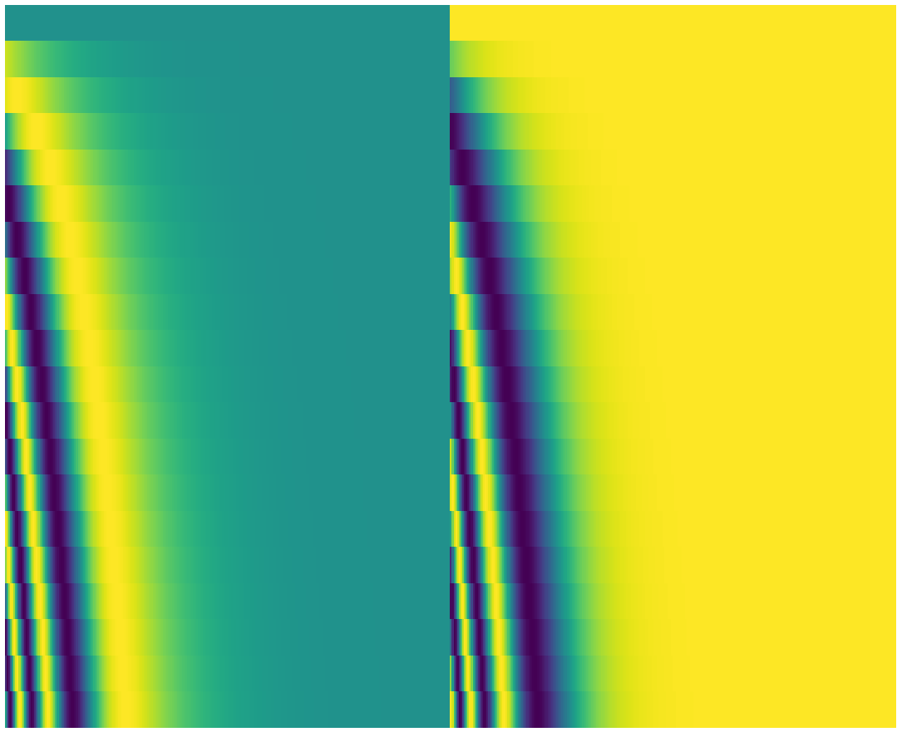
Positional Encoding
In Image, it appears split in half down the center. That's because the values of the left half are generated by one function (which uses sine), and the right half is generated by another function (which uses cosine).

Slide 24
Big Bird
The self-attention mechanism overcomes constraints of RNNs (namely the sequential nature of RNN) by allowing each token in the input sequence to attend independently to every other token in the sequence.
full self-attention have computational and memory requirement that is quadratic in the sequence length.
Using commonly available current hardware and model sizes, this requirement translates to roughly being able to handle input sequences of length 512 tokens.
The proposed sparse attention can handle sequences of length up to 8x of what was previously possible using similar hardware.
BIGBIRD is a universal approximator of sequence functions and is Turing complete, thereby preserving these properties of the quadratic, full attention model.

Slide 25
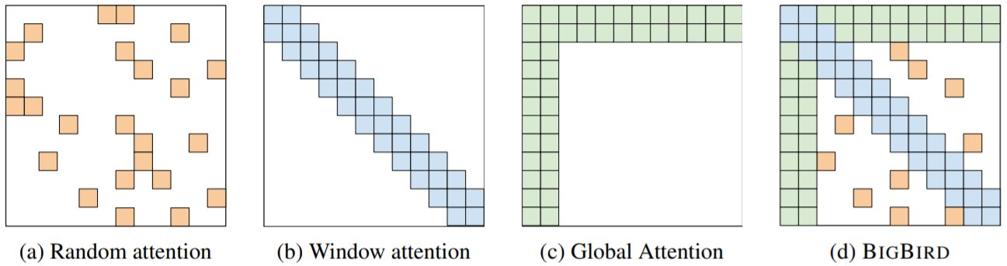
Sparse Linear Attention

Slide 26
Key contributions
BIGBIRD satisfies all the known theoretical properties of full transformer (Sec. 3). In particular, It is shown that adding extra tokens allows one to express all continuous sequence to sequence functions with only O(n)-inner products. Furthermore, we show that under standard assumptions regarding precision, BIGBIRD is Turing complete.
BIGBIRD achieve state of the art results for question answering and document summarization on a number of different datasets.

Slide 27
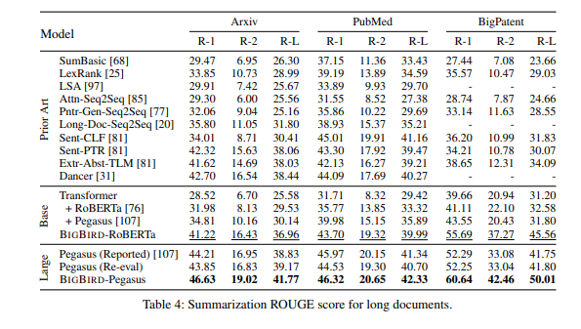
Results

Slide 28
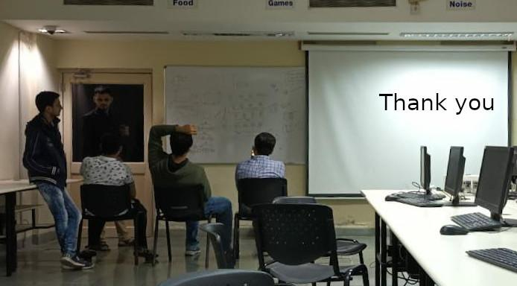

Slide 29
References
Jay alammar’s blog: https://jalammar.github.io/illustrated-transformer/
Vaswani, Ashish, et al. "Attention is all you need." Advances in neural information processing systems. 2017.
Zaheer, Manzil, et al. "Big Bird: Transformers for Longer Sequences." NeurIPS. 2020.

